Slide 1

Studio Project
(Final Presentation)
- IoT anyware -
Team Number One (Eagle5)
26th, Jun 2015
Notes:
Hi, My name is Jangsu Lee.
I’m a member of Team number one.
From now, I want to introduce our IoT system to you. called IoT anyware

Slide 2
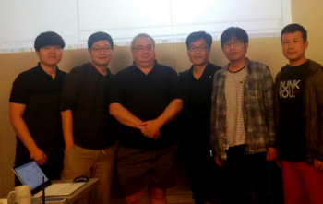
Table of Contents
Team Introduction
Project Context
Architecture Drivers Summary
Key Functional Requirements, QAs, Constraints
Architecture Design
System Context
Design (IoT System, IoT Server, SA node, User App)
Test Results
Project Plan
Time Log, Earned Value Management
Lessons Learned
Q&A and DEMO
Appendix
Notes:
In section 1, I will introduce our team
I’ll show our planning and doing in section 2.
Architectural analysis and design will show in section Three to Five
I will explain how we tested our system in section 6.
Finally, I will present “Lessons learned” through this project.

Slide 3






Team Introduction
Title
Team Leader / Managing Engineer
Name
Jangsu Lee
Assignment:
- Testing & Management
- Requirement Analysis
- Architecture Design
Mentor :
Daniel Plakosh
Title
Technical Writer /
Requirements Eng.
Title
Chief Architect / Support Engineer
Title
Developer
Title
Developer
Name
Yoonki Hong
Name
Jeonggil Lee
Name
Changwook Lim
Name
Jaehoon Kim
Assignment:
- IoT Infrastructure
- Requirement Analysis
- Architecture Design
Assignment:
- IoT Infrastructure
- Requirement Analysis
- Architecture Design
Assignment:
- SA Node
- Requirement Analysis
- Architecture Design
Assignment:
- User Interface
- Requirement Analysis
- Architecture Design
Legend
Role
Name
Job Assign
Face
Mentor
Order
Notes:
Here are my team members. (pointing) and our mentor DAN.
It looks like layered pattern. If I order, they have to do, maybe do.

Slide 4
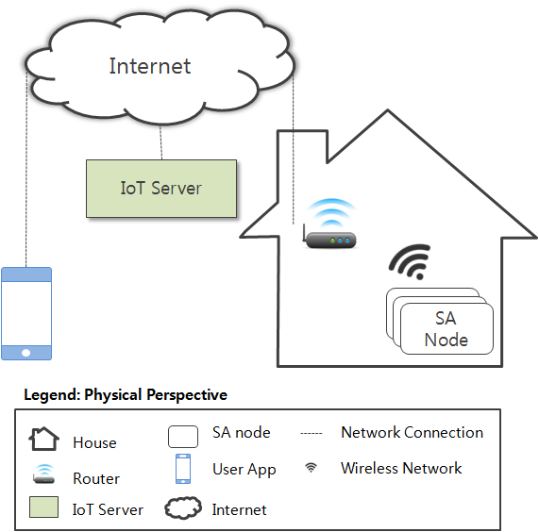
Project Context
Project Goal
- Support accessing sensors and actuators installed in the home or business.
- Provide an ecosystem to develop IoT products.
- Provide IoT data sets for developers to create future data mining, analytic operations, and services.
Stakeholders
- Anthony J. Latanze
- Consumers
- Sensor/Actuator Producers
- Home Builders
- IoT Application Developers

Slide 5
Architecture Drivers (1/2)
< Key Function Requirements>
Access secured services | FR01
Description: User accesses the system in secured environment. User must login to the system for services. Unauthorized persons are not allowed to control sensors installed in home, register SA Nodes, or access any data gathered in the system.
Send emergency message | FR05
Description: An emergency message is sent to the user when door is opened manually or the house is suddenly occupied while alarm is set.
Lock house automatically | FR06
Description: User is informed upon the vacancy of house and asked to lock the house. If the user failed to respond to the message within 5 minutes, the door is closed, and the alarm is set automatically.
Register SA node | FR08
Description: User adds nodes to the system. Equipped sensors and actuators are recognized.
Sharing SA node control right to other user | FR10
Description: User who registered a node is able to give a right (FR03) to other user (e.g. his/her child, his/her mom, or other family).

Slide 6
Architecture Drivers (2/2)
< Key Quality Attributes >
 | High Priority | Medium Priority | Low Priority
Number of QAs | 5 | 4 | 0
ID | PRI | Quality Attribute | Descriptions
QA01 | H | Security User Authorization | Hackers or malicious people try to break into the system. When unauthorized user attempts to login to the system, the system maintains the audit trail. If the attempt is repeated more than 5 times, the account is locked, and the source of tempering is identified
QA02 | H | Security Secure registration of SA node | Hackers or malicious people try to register the SA node that is not owned by them. When unauthorized user attempts to register the SA node that he/she doesn’t own, the system maintains the audit trail, and cancels the registration in 10 minutes.
QA03 | H | Availability | SA node can crash, hang, or be disconnected from the network for various reasons. If SA node is inoperable or out of reach, the system should be aware of such events, and notify user within 1 minutes.
QA07 | H | Modifiability | The system should make it easy to add emerging protocols (eg. Bluetooth 802.15, ZigBee 802.15.4) to the system. Average skilled developers should be able to implement it within two months.
QA09 | H | Extensibility | The system should make it easy for application developers (private persons, VARs, or other 3rd parties) to build custom apps, services, and/or make mashups from existing available services. Average skilled developers should be able to build the application in six months.
Notes:
We derived high five quality attributes from the requirements.
QA01 is about user authorization.
QA02 is for secure registration of SA node.
QA03 is about availability of SA node.
Modifiability for Emerging protocol
And Extensibility for ecosystem are most important also.

Slide 7
Constraints
ID | Type | Description
TC01 | Technical | JAVA compiler, Arduino 1.0.6 is preferred.
TC02 | Technical | Permissible languages for this system (excluding the SA nodes) are JAVA and Python.
TC03 | Technical | 802.11 is only supported in the system.
TB01 | Business | Development period: 5 weeks (3 hours/day)
TB02 | Business | Development team: 5 developers.

Slide 8
IoT System Context Diagram
IoT
Server
User
App
Control
& Inform State
SA node
Communicate
End user
Logging
User Command
& SA node state
Build custom IoT SW/HW
Log DB
3rd party Developer
SMS, Email send
& Information Service
ISP
Build & mashups IoT services
Value added reseller
IoT
System
IoT
Server
External Entity
X
Y
People
Interaction between
X and Y
Notes:
This diagram shows the first approach of our system design.
We provide a IoT service for user to interact with their SA.
And for the expansion of ecosystem.
We should provide open frameworks for the developers.
And open services to market participants.

Slide 9
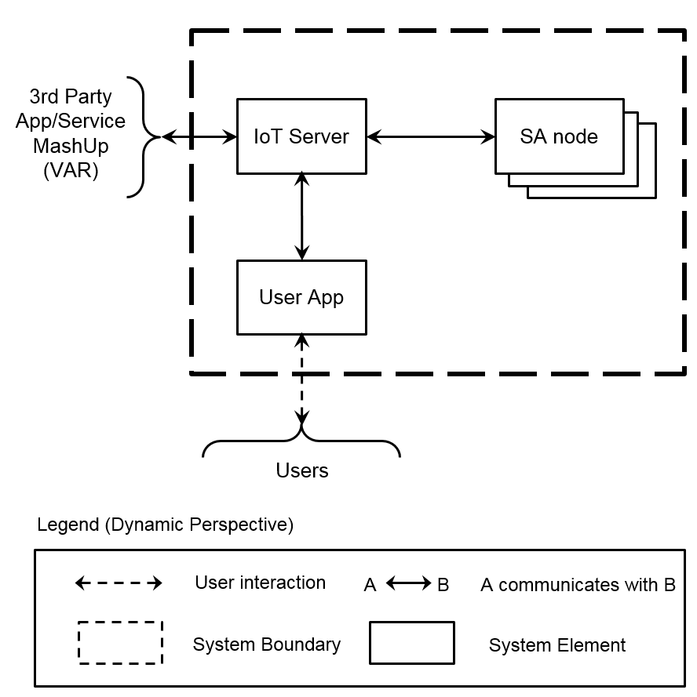
IoT System : Deployment
Dynamic
Physical
Notes:
So, we broke our system into 3 major entities.
User App for End user, SA node, and IoT Server for the service
They will be located as the picture.
User device could be anywhere.
SA Node also could be everywhere in near future.
So we should consider it in our system design.
Easy to join/Easy to leave

Slide 10
IoT Server : Dynamic - 1st Decomposition (1/2)
Quality Attribute | QA09 Extensibility | Pattern | Publish-Subscribe
Rationale | Loose coupling (vs. Client-Server) Don’t need to know remote elements Easy to add elements
Concern | Performance degradation(Refer to “Performance Experiment”) - Increased network traffic by huge number of SA node Security - Non-trust relationship between publisher and subscriber.
Event Bus
Dynamic Perspective
Legend
A
B
A communicates with B by Event
3rd Party App/Service MashUp (VAR)
Network Connection
IoT Server Runtime
Process
IoT Server Boundary
User App
SA Node
Notes:
As mentioned, extensibility is important Quality Attribute of our system.
Compared to Client Server,
PuB/SuB pattern has an advantage for scalable network.
So we considered applying Pub-Sub pattern to IoT Server via Event Bus.
Performance degrading by increasing SA node
And Security might be main concern.
IoT Server consists of two elements.
Event Bus and IoT Server Runtime. I will explain later.

Slide 11
IoT Server : Dynamic - 1st Decomposition (2/2)
Quality Attribute | QA03 Availability | Tactic | HeartBeat
Rationale | To detect the failure of SA node. To notify failure to User App. To reduce event traffic (vs. Ping/Echo)
Concern | Performance degradation (Refer to “Performance Experiment”) - Workload increasing by Heartbeat event - Network congestion by concurrent generation.
Do Experiment
☞
Event Bus
Dynamic Perspective
Legend
A
B
A sends HeartBeat to B
How often ?
IoT Server Runtime
A
B
A sends failure to B
Process
IoT Server Boundary
User App
SA Node
Notes:
Another important Quality Attribute
is Availability for the detecting failure of SA node.
We applied HeartBeat tactic to the Event Bus.
But by the HeartBeat event,
Performance issue could happen on the bus.
So, We need to know how often the node should send HearBeat.
I don’t know, So we did Experiment.

Slide 12
IoT Server : Dynamic - 2nd Decomposition (1/3)
< IoT Server Runtime >
Event Bus
IoT Server Runtime
Event Bus
Event Manager
Logging
- Command / State
Monitoring
- Events / Traffic
Sensor Data Store
User Data
Store
Sensor Data Store
Event Manager
Web Server
Web Server
User Account
- Create / Log in
SA node
- Register/Unregister
User App
SA Node
3rd Party App/Service Mash-Up (VAR)
Legend (Dynamic Perspective)
Network Connection
A
B
Data Flow
Process
A
B
A communicates with B by Event
RDBMS Database
NoSQL Database
IoT Server Runtime Boundary
Notes:
Then we decomposed each IoT server elemements. IoT runtime and Event bus.
This is the decomposition of IoT Runtime.
It includes Event Manager and Web Server.
Web server is responsible for user account and SA node register.
Event manager is monitoring and logging event bus.
There are 2 kinds of database,
RDMBS is for user data, NoSQL is for the logs.

Slide 13
IoT Server : Dynamic - 2nd Decomposition (2/3)
< Event Bus>
Event Bus
IoT Server Runtime
MQTT Broker
Publish /Subscribe
Event
MQTT Broker
MQTT Proxy
Secure access
- User App
- SA Node
MQTT Proxy
IoT Server Runtime
User App
SA Node
3rd Party App/Service MashUp (VAR)
Legend (Dynamic Perspective)
Network Connection
A
B
A sends event to B
Event Bus Boundary
Process
Notes:
It shows decomposition of Event Bus.
Event bus includes two components; MQTT Proxy and MQTT Broker.
MQTT proxy is responsible for secured access of SA node and User App.
And MQTT Broker is doing basic functionality of event bus such as pub-sub.

Slide 14
IoT Server : Dynamic - 2nd Decomposition (3/3)
Quality Attribute | QA01 Security | Tactic | Authenticate Actors
Rationale | To resist unauthorized access - Account Manager issues Session ID for Event Bus access - Session ID is valid only for limited time period
Event Bus
MQTT Broker
4
5
Web Server
(Account Manager)
MQTT Proxy
IoT Server Runtime
3
6
User App
1
User App
SA Node
3rd Party App/Service MashUp (VAR)
2
Legend (Dynamic Perspective)
Legend (Dynamic Perspective)
Control Flow
(SSH encrypted)
Network Connection
A
B
A sends event to B
Application
Process
Event Bus Boundary
Process
Notes:
This picture explains the IoT server in terms of security.
To access Event bus, The user app should access the web server first then get session ID
With the session ID, User App tries to join the Event Bus.
Event Bus check with Web server to confirm the access.
The channel will be encrypted with SSL and the session has valid time.

Slide 15
IoT System - Register Sequence Diagram
Quality Attribute | QA02 Security | Tactic | Authorize Actors
Rationale | To permit secured SA node registration To refuse unproven SA node
USER
USER APP
IoT Server
SA Node
1: SA Node register
Enter S/N of new Node
2: Req. SA Node Register
3: Req. to manipulate SA Node
4: Show guide about manipulate
< 10 minutes
5: Manipulate SA Node
6: Request Connection
7: Response
8: Send S/N
10: Complete Register
9: Response
Notes:
This sequence diagram shows how the SA node is registered securely .
User has to register Serial number to the server first.
Then user manipulate SA node and SA node accesses the server,
Then it has been registered.
If the SA node is not registered with in 10 minute. The transaction is refused.

Slide 16



IoT System - Physical Perspective
Quality Attribute | Availability | Tactic | Passive Redundancy
Rationale | To be recovered from the redundant spare Zone, when IoT Server doesn’t work Switchable two Zones with periodic database updates
HTTPS
ports 443
gunicorn 19.3.0
WSGI
flask 0.10.1
mysqld 5.5.43
flask 0.10.1
flask 0.10.1
Web Browser
User App
flask 0.10.1
MQTT
ports 1883, 8080
HTTPS, MQTT
mosquitto 3.1
mongod 2.4.9
INTERNET
Ubuntu Server 14.04 LTS / Zone A
HTTPS,
MQTT
Firewall
Ubuntu Server 14.04 LTS / Zone B
Legend (Physical Perspective)
Server machine
User machine
Communication
protocol
Load balancer
Server software running on a machine
SA node
Notes:
Our IoT server infrastructure is serviced with Amazon Web Services(AWS).
In order to support high availability.
It is deployed across multiple (availability) zones.
There is a load balancer and redundant spare zone.

Slide 17
SA node : Static - 1st Decomposition
Quality Attribute | QA09 Extensibility (Portability) | Pattern | Layer
Rationale | Easy to port SA node program to various hardware - Extension of Hardware Abstract Layer of SA Controller
SA Manager
SA Controller
Sensor & Actuator
Abstract
SA Controller
(HAL)
SA Network Manager
SA Network Manager
Network Protocol
Abstract
Arduino Driver
MQTT Adaptor
Legend (Static Perspective)
Middleware Layer
A
B
: A is allowed
to use B
Abstract Layer
Concrete Layer
Notes:
SA node is designed to layered pattern.
Abstract Layer is consist of two modules.
SA Controller and SA Network Manager.
SA Controller provides the abstraction of the sensor and actuator,
And Network Manager provides the abstraction for supporting,
not only event bus but also emerging network protocols.

Slide 18
SA node : Dynamic - 2nd Decomposition
Quality Attribute | QA07 Modifiability | Pattern | Light Weight Broker
Rationale | Easy to add the emerging network protocol. - Extension of Emerging Protocol Bridge. - Mediation of Network Broker.
SA Network Manager in Master SA node
(WIFI and Emerging Protocol)
Network Broker
SA Manager
Legend(Dynamic Perspective)
To support
Emerging protocol
Module
Instance
Slave
SA node
(Emerging Protocol)
Publish-Subscribe
Interface
Emerging Protocol
Bridge (e.g BT)
SA Network Manager Boundary
A
B
: A call B
A
B
User App
: A communicates
with B by Event
MQTT Adaptor
: Emerging Protocol
Notes:
This is SA Network Manager decomposition.
Now, SA node communicates with IoT Server via WIFI.
However, SA node is designed to support the emerging protocol,
without WIFI via Protocol Bridge.

Slide 19
User App : Dynamic - 1st Decomposition
Quality Attribute | QA09 Extensibility | Pattern | MVC
Rationale | Easy to add new View - Hide the interaction between View and IoT Server Easy to reuse Controller and Model for new View.
<<Observe>>
View
Controller
Model
User
Web Server
Event Bus
Legend (Dynamic Perspective)
User App boundary
Network Connection
A
B
A observes B
A
B
A sends user inputs to B
Run time object
A
B
A updates the B’s data
User interacts with View
Notes:
User App consists of three interconnected components,
View, Controller, and Model.
MVC pattern is adapted for 3rd party developers
to build various user interfaces easily.

Slide 20
User App : Static - 2nd Decomposition
Quality Attribute | QA09 Extensibility | Pattern | Object Oriented
Rationale | Easy to add new SA node Easy to modify for changing of IoT Server - Adaptor Pattern(Server Interface/HTTP Adaptor)
View Pkg
Control Pkg
Model Pkg
<<interface>>
Server
Controller
Model
SANode
SANode
Node
HTTPRESTClient
HTTPAdaptor
MQTTClient
IoTDataset
SensorActuator
SensorActuator
SensorActuator
SensorActuator
Legend (Static Perspective)
Class
A
B
A associates with B
A
B
A implements B
Package
A
B
A uses B
Notes:
This diagram presents static structure of User App.
Controller uses HTTPRESTClient and MQTTClient.

Slide 21
Test Cases
 | Test Basic (TB) | Test Complex (TC) | Test Negative (TN) | Total
Number of Test Cases | 10 | 7 | 4 | 21
No. TB-03 | SA node register
Relevant Function Requirement Quality Attribute | FR08 : Register SA nodes QA02 : Security – Unauthorized SA node register
Pre-Condition | User is aware of Serial Number of SA node. SA node is not registered in advance. User logged into the server in advance.
Test Procedure | 1. Make sure logged into the server in advance. 2. Select “1.Register SA node” menu. 3. Input [nodeID]/[nickname], then press “Enter” 4. Manipulate SA node to register within 10 minutes.
Pass/Fail Criteria | Pass: (1) SA node is registered successfully. (2) App notifies the node is registered. (3) App shows updated node list. Possible Failures: (1) nodeID is registered already to the server. (2) SA node is not registered to the server within 10 minutes.
Test Results
Notes:
To test IoT System.
We set test plan and derived total 21 test cases.
They were categorized into 3 parts (Basic, Complex, Negative).
We specified FR,QA related with each case.

Slide 22
Test Results (1/2)
ID | Description | Relevant FR, QA |  | Pass | Fail
TB-01 | Register new user account | FR01 | QA01, QA02 | O
TB-02 | Log into the IoT server | FR01, FR02 | QA01 | O
TB-03 | SA node register | FR08 | QA02 | O
TB-04 | SA node unregister | FR09 | QA02 | O
TB-05 | Update SA node status | FR03 |  | O
TB-06 | Determine sensors(Humidity/Temperature/Presence) | FR03 |  | O
TB-07 | Turn on/off the light | FR03 |  | O
TB-08 | Open/close the door | FR03 |  | O
TB-09 | Set/Get log configuration | FR04 |  | O
TB-10 | View log | FR04 | QA03 | O
Notes:
Basic and complex cases are mainly focused on Functional requirement.

Slide 23
Test Results (2/2)
ID | Description | Relevant FR, QA |  | Pass | Fail
TC-01 | Turn off light automatically | FR07 |  | O
TC-02 | Send emergency message | FR05 |  | O
TC-03 | Lock house automatically | FR06 |  | O
TC-04 | Lock house and turn off light automatically | FR06, FR07 |  | O
TC-05 | Mail box register | FR03 |  | O
TC-06 | Unlock door while alarm is set | FR08 |  | O
TC-07 | Mail box notification | FR05 |  | O
TN-01 | Notify SA node unavailability |  | QA03 | O
TN-02 | Authentication fail |  | QA01 | O
TN-03 | Log into server again |  | QA01 | O
TN-04 | Register unproved SA node |  | QA02 | O
QA01 - Security : Authentication & Authorization
QA02 - Security : Unauthorized SA node register
QA03 - Availability : Notify unavailability to user
Notes:
Negative tests are focused on Quality attribute.

Slide 24
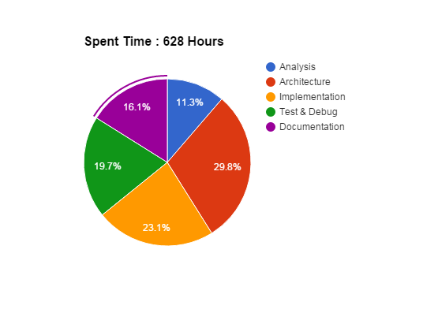
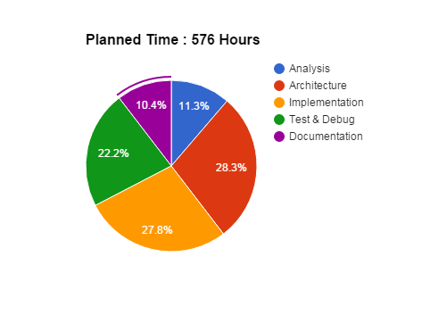
Project Plan - Time Log
Planned Time : 576 Hours
Spent Time : 628 Hours
+ 52 Hours
Risk : Low Java Skills
 | Analysis | Architecture | Implementation | Test & Debug | Documentation | Total
Planned Time | 65 | 163 | 160 | 128 | 60 | 576
Actual Time | 71 | 187 | 145 | 124 | 101 | 628
Difference | (6) | (24) | 15 | 4 | (41) | (52)
Notes:
Actual time spent is different with original plan.
We thought that low JAVA skill was high risk at first.
But it is not, because there are many many commodity SWs in the world.
Instead, actual risks are design & documentation skill.
In result, we spent more time on architecture&documentation.

Slide 25
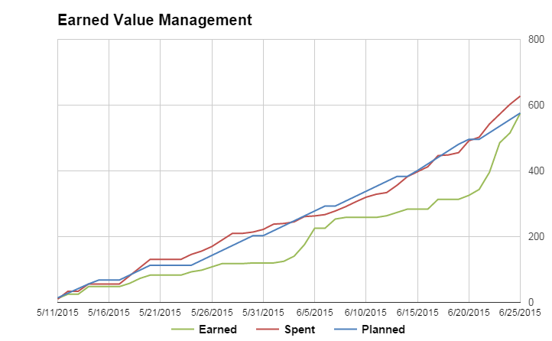
Project Plan – Earned Value Management
Earned Value Management
Earned Value | 576
Actual Efforts | 628
+ 52 Hours
Development Period | Day off (Exam, Moving) | Working Day | Actual Effort | Persons | Day workload per Person
5/11~6/24 (46 Days) | 11 Days | 35 Days | 628 Hours | 5 | 628 H / 35 day / 5 person = 3.58 Hours
Notes:
We started this project on May 11 from Korea.
Each person worked three and half hours a day.
It’s average~!

Slide 26


Lessons Learned
☞ Do not mix the perspective
- We’ve met communication error
☞ Experiment is very important
- If you don’t know event bus, how to know QA
☞ Architectural documents HAVE TO be matched with design
☞ We MUST consider not only FR but also QA,
- Functional requirements is not enough for design
☞ Do TALK with stakeholder
Notes:
Here are the lessons learned through this project.
I ordered that each member should write 1 lesson. So there can be 4 items.
Don’t stay in the deep sea even thought it is more comport place to engineer.
Thank you.
(They are evenly allocated 4 itmes to my 4 member.)

Slide 27

Q&A
Notes:
Ask if there are any questions about our Studio project or IoT system.
Please give our colleagues a chance to answer the question.

Slide 28
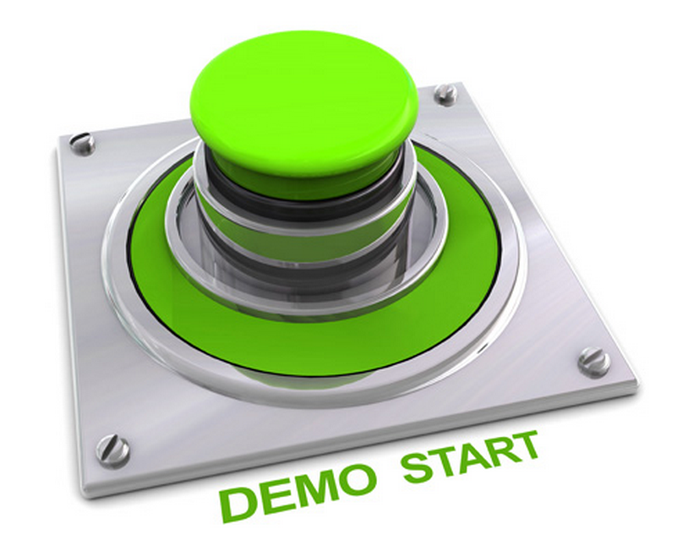
Let’s Start DEMO
Notes:
(18분안에 presentation 완료)

Slide 29
Contents of Appendix
Appendix A - Experiments (Event Bus)
Appendix B - Decomposition of Web Server
Appendix C - Decomposition of Event Manager
Appendix D - Static Perspective of IoT Server
Appendix E - Sequence Diagram(Make Account and Login)
Appendix F - Dynamic Behavior of User App
Appendix G - QA Scenario

Slide 30
Appendix A - Event Bus Experiment (1/3)
Test Environment
AWS EC2 Instance(m3.medium)
OS: Ubuntu 14.04.2 LTS (GNU/Linux 3.13.0-48-generic x86_64)
CPU: 1 x Intel(R) Xeon(R) CPU E5-2670 v2 @ 2.50GHz
MEM: 3.75GB
Configuration Tuning
/etc/sysctl.conf
/etc/security/limits.conf
net.ipv4.ip_local_port_range = 1024 65535 net.ipv4.tcp_tw_reuse='1' # enable reusing socket in TIME_WAIT state net.ipv4.tcp_fin_timeout = 10 # decrease time for socket to stay in TIME_WAIT state net.ipv4.tcp_rmem = 4096 16384 3355443 # TCP Read Buffer size net.ipv4.tcp_wmem = 4096 16384 3355443 # TCP Write Buffer size
* soft nofile 1048576 * hard nofile 1048576
Notes:
This is a Amazon server spec we are using.
We put virtual SA nodes to this bus and they generates HearBeat periodically. (Randomize ?)

Slide 31
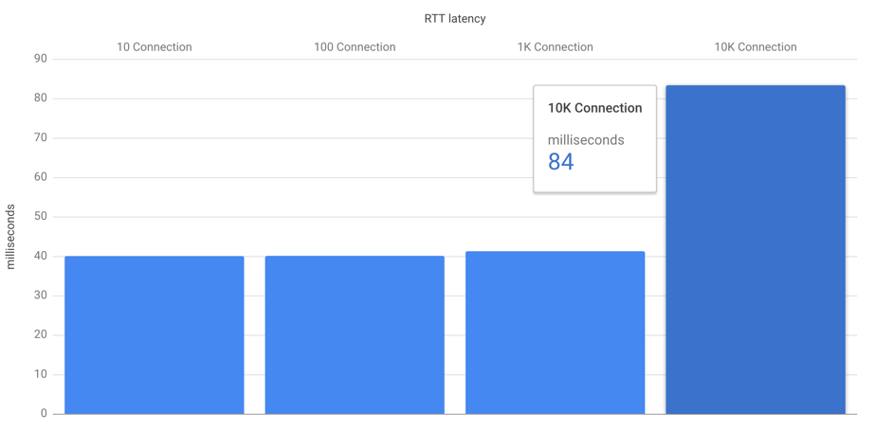
Appendix A - Event Bus Experiment (2/3)
Pre-condition | N. of virtual SA nodes are being connected to the Event Bus. They all are sending Heartbeat event every 10 seconds.
Test Scenario | User App sends the control event to a SA node and receives the status event from it.
Measurement Matrix | X-axis : N. of connections Y-axis : t4 - t1
Result | Max 1000 SA nodes do not effect on performance.
Workload Generator
Event Bus
milliseconds
t1
t4
t3
t2
User App
SA Node
Connections

Slide 32
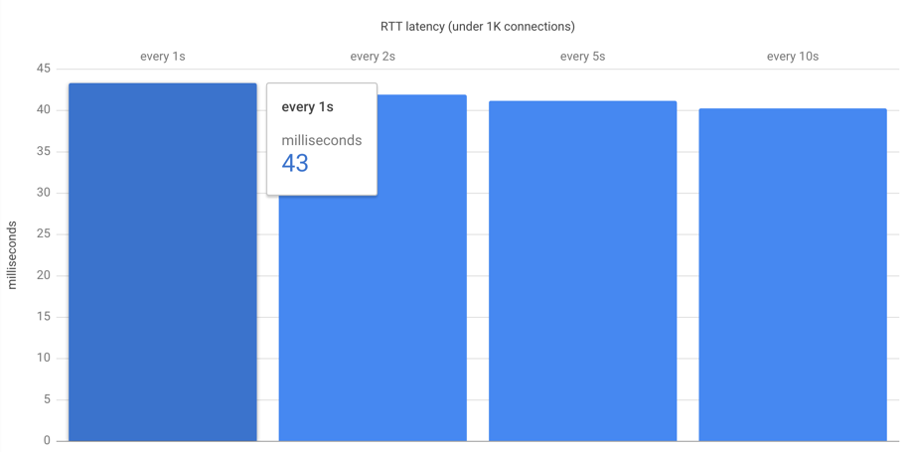
Appendix A - Event Bus Experiment (3/3)
Pre-condition | 1000 virtual SA nodes are being connected to the Event Bus. They all are sending Heartbeat event every N seconds.
Test Scenario | User App sends the control event to a SA node and receives the status event from it.
Measurement Matrix | X-axis : N sec cycle. Y-axis : t4 - t1
Result | Min 10 sec cycle Heartbeat does not affect the performance
Workload Generator
Event Bus
milliseconds
t1
t4
t3
t2
User App
SA Node
Connections

Slide 33
Appendix B - Decomposition of Web Server (Dynamic Perspective)
SMTP Service
Sensor Data Store
Log Viewer
Auth Manager
User Data Store
User App
SA Node
3rd Party App/Service MashUp (VAR)
Legend (Dynamic Perspective)
Network Connection
A
B
Data Access
Process
Web Server Boundary
External Service
Notes:
사용자에 대한 인증, SA Node 관리와 Log에 대한 조회는 서로 다른 Workload의 특성을 갖고 있기 때문에 해당 기능을 처리하는 모듈을 분리합니다. Log 조회는 1) 단방향으로 처리되는 Event가 아니라 응답이 필요한 Request/Response 형식이며, 2) Event Bus의 성능에 영향이 있을 수 있을 만큼 데이터 사이즈가 크기 때문에 Log Viwer에서 처리 합니다. Log Viewer는 log 조회 요청을 받으면, Auth Manager를 통해서 사용자가 설정한 logging timewindow와 사용자에게 등록된 SA node의 목록을 확인한 이후에, 관련된 log를 Sensor Data Store(NoSQL)에서 조회해서 결과를 응답합니다. Auth Manager 모듈은 시스템을 사용하려는 사용자에 대한 본인 인증을 위해, 사용자의 계정 등록 요청 시에 사용자의 email 주소로 인증 확인을 위한 link가 포함된 메일을 발송합니다. 해당 메일은 보안을 위해서 10분의 유효기간 이후에 만료됩니다.

Slide 34
Appendix C - Decomposition of Event Manager (Dynamic Perspective)
Weather Service
SMTP Service
SMS Service
Sensor Data Store
Logger
Service Broker
Rule Manager
Heartbeat
Manager
Push Manager
User Data Store
Event Listener
Event Bus
Legend (Dynamic Perspective)
Network Connection
A
B
Data Access
Process
A
B
A sends an event to B
Server Element Boundary
Data Repository
Thread
External Service
Notes:
Event Manager는 Event Server와의 연결을 생성합니다.
이후에 특정 topic에 대해서 처리를 위해서 Event handler thread들을 생성합니다.
Event handler thread는 Event Manager에서 생성한 connection을 공유하며,
Logger는 SA node에서 상태 변화 시에 발생하는 Event와, 사용자의 SA node에 대한 제어 Event에 대한 저장을 담당합니다.
Rule Manager는 SA node와 관련된 rule을 관리하며, SA node의 현재 상태와, 외부 정보를 확인해서 일정 조건이
만족 될 경우에 SA node에게 제어를 요청 합니다.
(i.e. 비가 내릴 것이 예보된 상황에서, SA node의 door가 열려 있는 상황).
관련해서 SA node의 내부 상태만으로 처리할 수 있는 rule에 대해서는, Server와
SA node의 연결이 끊어져도 일관성 있게 기능을 보장을 하기 위해서 SA node에 저장됩니다.
정보를 제공하는 service provider에 대한 의존성을 느슨하게 가져가기 위해서, 관련 처리는 Service Broker가 담당합니다.
Heartbeat Manager는 SA node가 주기적으로 발생시키는 heartbeat를 관리하며,
3번 연속으로 heartbeat가 누락된 SA node에 대해서는 사용자에게 해당 내용을 전달 합니다.
Push Manager는 SA node가 발생시킨 alarm에 대해서 사용자에게 전달 합니다.
발생된 SA node에 대한 alarm을 받을 사용자와 메시지 수신을 위한 상세 주소를 확인하기 위해서 User Data Store (RDBMS)를 통한 조회합니다.
사용자가 User App을 실행하고 있지 않은 경우에 대해서도 메시지를 전달 하기 위해서 Event Bus 이외의 Email/SMS를 추가로 사용 합니다.

Slide 35
Appendix D - Static Perspective of IoT Server(1/2)
Views
Views
Views
Account Module
Profile Module
User Module
Log Module
Session Module
Decorator
ORM Model
Web Framework
Argument Check Module
Session / Auth Check Module
mysql Binding Module
mongoDB Binding Module
Token handling Module
Legend (Static Perspective)
Code module (Class or classes)
Module X
Uses Module Y
Functional
Group
X
Y
Extenrl Code module (Class or classes)
Notes:
WebServer는 Web Framework를 사용해서, 서버에 대한 REST 요청과 응답을 처리합니다. REST 요청을 구성하는 API는 각각 Account, Profile, User, Log 그리고 Session Module로 책임을 나눕니다. 각각의 Module들이 공통으로 요청에 대해서 필요한 기능은 Decorator Module이 제공합니다. Decorator 모듈은 API에 정의된 mandatory 항목이 Header와 Body에모두 존재 하는 지와 해당 항목의 값이 유효한지를 확인하는 Argument Check Module과, 세션관리를 위한 Session / Auth Check Module로 구분이 됩니다. WebServer에서는 DB에 대한 의존성을 줄이기 위해서, DB에 저장되는 항목을 ORM Model로 추상화 해서 사용하며, ORM Model은 추상화된 class에 대해서 구체적인 SQL 언어로 변환해서 DBMS에 요청을 합니다.

Slide 36
Appendix D - Static Perspective of IoT Server(2/2)
Event Daemon
Logger Module
Rule Mgmt. Module
Service Broker
Push Noti. Module
Heartbeat
Module
MQTT Binding Module
mongoDB Binding Module
mysql Binding Module
Service Proxy
SMTP Module
Legend (Static Perspective)
Code module (Class or classes)
Module X
Uses Module Y
Functional
Group
X
Y
Extenrl Code module (Class or classes)
Notes:
Event Manager는 MQTT Binding Module을 사용해서, Event Bus에서 발생하는 Event를 수신하고, Event Bus에 새로운 Event를 발생 시킵니다. 사용자에 대한 정보를 조회할 필요가 있는 Push Notification Module과 Rule Management Module은 mysql Binding Module을 통해서 User Data Store에 접근을 하며, SA Node에서 발생하는 Event의 logging을 위해서 Logger Module은 mongoDB Binding Module을 사용해서 Sensor Data Store에 접근 합니다. Rule Management Module에서 외부 서비스의 정보를 조회하기 위해서 Service Broker를 사용하며, 의존성을 느슨하게 하기 위해서 각각의 서비스에 대한 상세 구현은 Proxy 모듈로 나뉩니다.

Slide 37
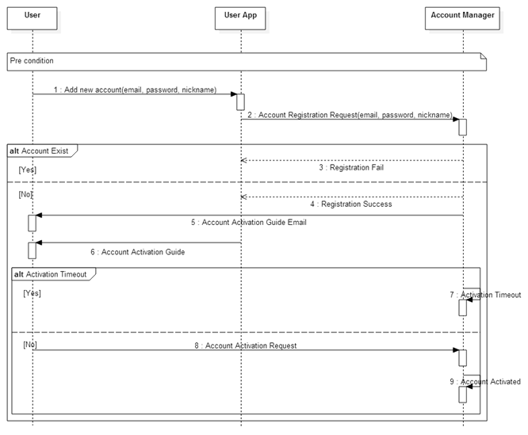
Appendix E - Sequence Diagram (Make New Account)

Slide 38
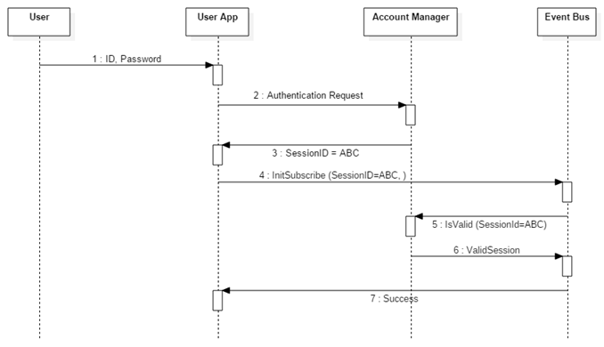
Appendix E - Sequence Diagram (Login)
Sequence diagram how to Check Valid User (QA01 Security)

Slide 39
Appendix F - Status Diagram of User View
App Start
Choose Node List
Welcome
Enter
Login Info
SA node List and System Config
Choose
SA node
SA node Status
Choose
Actuator
SA node Control
Choose
Node List
Choose
Node Status
Choose
Make
account
Enter
New Value
Choose
Welcome
Choose
Reg./Unreg
Choose
Config
Choose
Log view
Make Account
Register/Unregister SA nodes
Log Config
View Log
Notification (Alarm or Information)
Choose Node List
Legend (Dynamic Behavior)
Status of View
User Input – enter some kinds of data
Receive alarm message
User Input – choose one item

Slide 40
Appendix G – QA Scenario (1/5)
Security |  | ID: QA01
Quality Attribute: Hackers or ill minded people try to break into the system. When unauthorized user attempts to login to the system, the system maintains the audit trail. If the attempt is repeated more than 5 times, the account is locked, and the source of tempering is identified.
Stimulus | Login attempt with an Incorrect id or a password
Source(s) of the stimulus | Human or machine
Relevant environmental conditions | Normal operation
Architectural elements | System
System response | The system bans any further access, and logs all access attempts.
Response measure(s) | Five repeated attempts locks the account, and the source of tempering is identified.

Slide 41
Appendix G – QA Scenario (2/5)
Security |  | ID: QA02
Quality Attribute: Hackers or ill minded people try to register the SA node that is not owned by them. When unauthorized user attempts to register the SA node that he/she doesn’t own, the system maintains the audit trail, and cancel the registration in 10 minutes.
Stimulus | Unauthorized SA node registration
Source(s) of the stimulus | Human or machine
Relevant environmental conditions | Normal operation
Architectural elements | System
System response | The system prevents the registration of SA node of which ownership is not identified.
Response measure(s) | Undefined SA node registration is canceled in 10 minutes.

Slide 42
Appendix G – QA Scenario (3/5)
Availability |  | ID: QA03
Quality Attribute: SA node can crash, hang, or be disconnected from the network for various reasons. If SA node is inoperable or out of reach, the system should be aware of such events, and notify user within 1 minutes.
Stimulus | SA node failure
Source(s) of the stimulus | SA node
Relevant environmental conditions | Normal operation
Architectural elements | System, SA node
System response | The system monitors and detects the failure of SA node.
Response measure(s) | System notifies failure to user within 1 minutes.

Slide 43
Appendix G – QA Scenario (4/5)
Modifiability |  | ID: QA07
Quality Attribute: The system should make it easy to add emerging SA node protocols (eg. Bluetooth 802.15, ZigBee 802.15.4) to the system. Average skilled developers should be able to implement it within two months.
Stimulus | New protocols for SA node
Source(s) of the stimulus | Developer
Relevant environmental conditions | After release
Architectural elements | System, SA node
System response | New protocols is supported by the system and SA node.
Response measure(s) | Average skilled developers can implement it within two months.

Slide 44
Appendix G – QA Scenario (5/5)
Extensibility |  | ID: QA09
Quality Attribute: The system should make it easy for application developers (private persons, VARs, or other 3rd parties) to build custom apps, services, and/or make mashups from existing available services. Average skilled developers should be able to build the application in six months.
Stimulus | New application or service
Source(s) of the stimulus | Developers (including 3rd party), VARs
Relevant environmental conditions | After release
Architectural elements | System
System response | The system supports the new application/service.
Response measure(s) | Average skilled developers should be able to build the application in six months.

